Slide 1
OOPs | Object Oriented Design

Slide 2
Contents
Abstraction
Encapsulation
Inheritance
Polymorphism

Slide 3
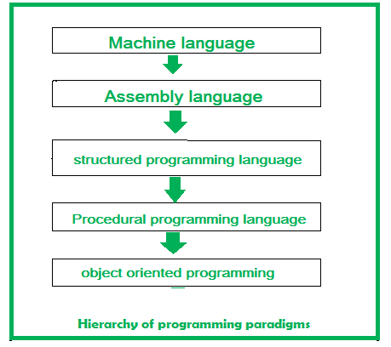
The earlier approaches to programming, there were several limitations. Like in procedural-oriented programming, you cannot reuse the code again & again in the program, and there was the problem of global data access, and the approach couldn’t solve the real-world problems very well.
In object-oriented programming, it is easy to maintain the code with the help of classes and objects.
Using inheritance, there is code reusability, i.e., you don’t have to write the same code again and again, which increases the simplicity of the program.
Concepts like encapsulation and abstraction provide data hiding as well.

Slide 4
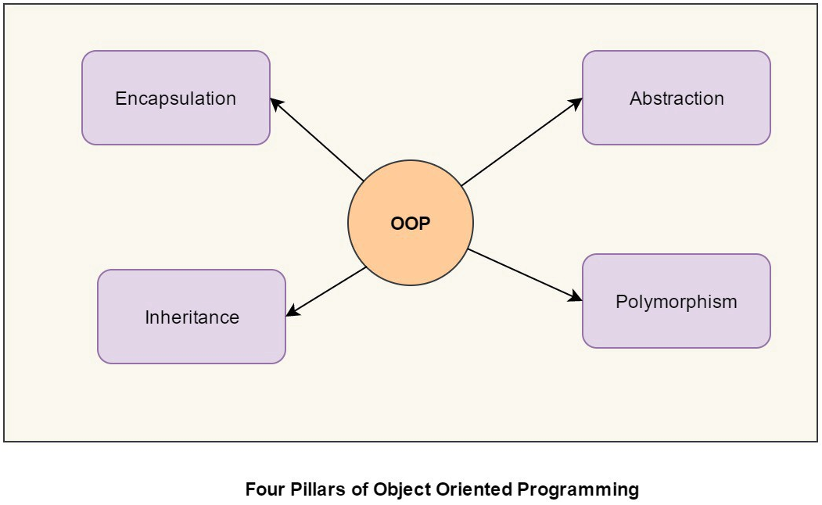
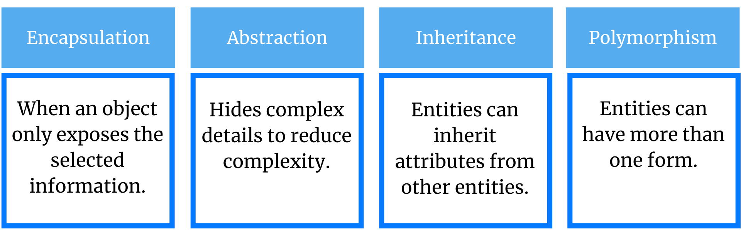
Object-Oriented Programming (OOP)
Object-oriented programming is a programming paradigm or style of programming that is centered around objects rather than functions.
The OOP concept was basically designed to overcome the drawback of the structural/procedural programming methodologies, which were not so close to real-world applications.
Object-oriented programming (OOP) is nothing but that which allows the writing of programs with the help of certain classes and real-time objects.
This approach is very close to the real-world and its applications because the state and behaviour of these classes and objects are almost the same as real-world objects.

Slide 5
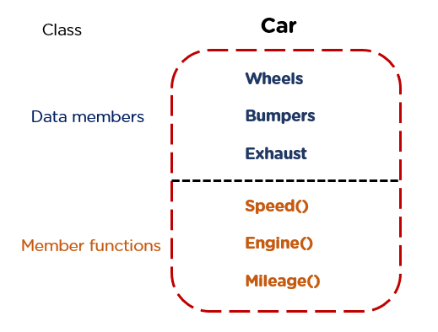
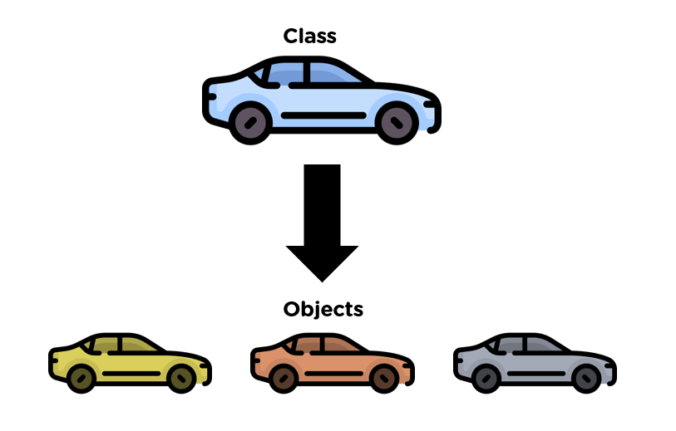
What Are Class & Object?
The basic concept of OOP is an extended concept of the structure used in C.
It is an abstract and user-defined data type. It consists of several variables and functions.
The primary purpose of the class is to store data and information. The members of a class define the behaviour of the class. A class is the blueprint of the object.
The class car has properties Wheels, Bumper and Exhaust. It resembles the real-world car that has the same specifications, which can be declared public (visible to everyone outside the class), protected, and private (visible to none). Also, there are some methods such as Speed(), Engine() and Mileage(). In the code given below, the car is a class and c1, c2 and c3 are object of the car.
c1
c2
c3

Slide 6
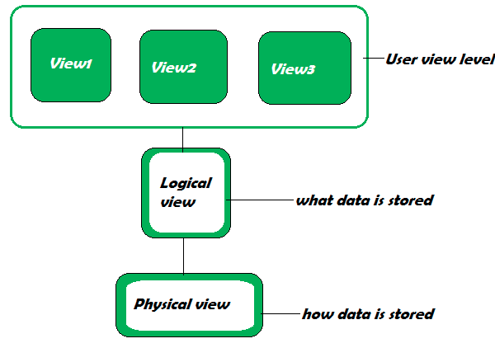
Data Abstraction
Abstraction refers to the act of representing important and special features without including the background details or explanation about that feature. Data abstraction simplifies database design.
Physical Level: It describes how the records are stored, which are often hidden from the user. Logical Level: It describes data stored in the database and the relationships between the data. The programmers generally work at this level as they are aware of the functions needed to maintain the relationships between the data. View Level: Application programs hide details of data types and information for security purposes, details that are meant for the user are shown.

Slide 7
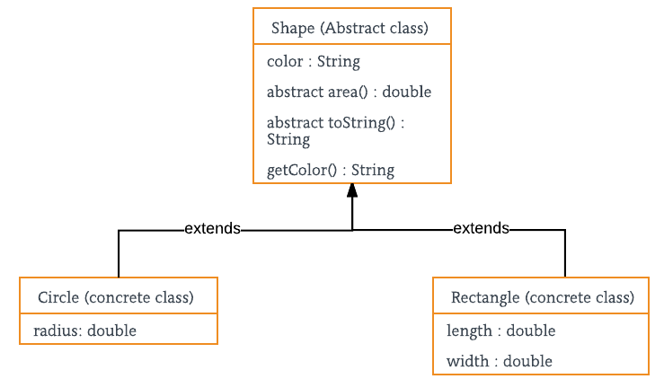
Abstraction in Java
Data Abstraction is the property by virtue of which only the essential details are displayed to the user. The trivial or the non-essentials units are not displayed to the user. Ex: A car is viewed as a car rather than its individual components.
Data Abstraction may also be defined as the process of identifying only the required characteristics of an object ignoring the irrelevant details. The properties and behaviours of an object differentiate it from other objects of similar type and also help in classifying/grouping the objects.
Consider a real-life example of a man driving a car. The man only knows that pressing the accelerators will increase the speed of a car or applying brakes will stop the car, but he does not know about how on pressing the accelerator the speed is actually increasing, he does not know about the inner mechanism of the car or the implementation of the accelerator, brakes, etc in the car. This is what abstraction is.
In java, abstraction is achieved by interfaces and abstract classes. We can achieve 100% abstraction using interfaces.
Abstract classes and Abstract methods :
An abstract class is a class that is declared with an abstract keyword.
An abstract method is a method that is declared without implementation.
An abstract class may or may not have all abstract methods. Some of them can be concrete methods
A method defined abstract must always be redefined in the subclass, thus making overriding compulsory OR either make the subclass itself abstract.
Any class that contains one or more abstract methods must also be declared with an abstract keyword.
There can be no object of an abstract class. That is, an abstract class can not be directly instantiated with the new operator.
An abstract class can have parameterized constructors and the default constructor is always present in an abstract class.

Slide 8
Abstraction in Java
When to use abstract classes and abstract methods
There are situations in which we will want to define a superclass that declares the structure of a given abstraction without providing a complete implementation of every method. That is, sometimes we will want to create a superclass that only defines a generalization form that will be shared by all of its subclasses, leaving it to each subclass to fill in the details.
Consider a classic “shape” example, perhaps used in a computer-aided design system or game simulation. The base type is “shape” and each shape has a color, size, and so on. From this, specific types of shapes are derived(inherited)-circle, square, triangle, and so on — each of which may have additional characteristics and behaviors. For example, certain shapes can be flipped. Some behaviors may be different, such as when you want to calculate the area of a shape.
Advantages of Abstraction
It reduces the complexity of viewing the things.
Avoids code duplication and increases reusability.
Helps to increase the security of an application or program as only important details are provided to the user.

Slide 9
class Circle extends Shape {
double radius;
public Circle(String color, double radius)
{
// calling Shape constructor
super(color);
System.out.println("Circle constructor called");
this.radius = radius;
}
@Override double area()
{
return Math.PI * Math.pow(radius, 2);
}
@Override public String toString()
{
return "Circle color is " + super.getColor()
+ "and area is : " + area();
}
}
class Rectangle extends Shape {
double length;
double width;
public Rectangle(String color, double length,
double width)
{
// calling Shape constructor
super(color);
System.out.println("Rectangle constructor called");
this.length = length;
this.width = width;
}
@Override double area() { return length * width; }
@Override public String toString()
{
return "Rectangle color is " + super.getColor()
+ "and area is : " + area();
}
}
// Java program to illustrate the
// concept of Abstraction
abstract class Shape {
String color;
// these are abstract methods
abstract double area();
public abstract String toString();
// abstract class can have the constructor
public Shape(String color)
{
System.out.println("Shape constructor called");
this.color = color;
}
// this is a concrete method
public String getColor() { return color; }
}
public class Test {
public static void main(String[] args)
{
Shape s1 = new Circle("Red", 2.2);
Shape s2 = new Rectangle("Yellow", 2, 4);
System.out.println(s1.toString());
System.out.println(s2.toString());
}
}

Slide 10
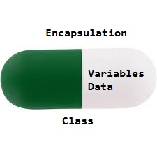
Encapsulation in Java
Encapsulation is defined as the wrapping up of data under a single unit. It is the mechanism that binds together code and the data it manipulates. Another way to think about encapsulation is, it is a protective shield that prevents the data from being accessed by the code outside this shield.
in encapsulation, the variables or data of a class is hidden from any other class and can be accessed only through any member function of its own class in which it is declared.
As in encapsulation, the data in a class is hidden from other classes using the data hiding concept which is achieved by making the members or methods of a class private.
Encapsulation can be achieved by Declaring all the variables in the class as private and writing public methods in the class to set and get the values of variables
It is more defined with setter and getter method.
Advantages of Encapsulation:
Data Hiding: The user will have no idea about the inner implementation of the class. It will not be visible to the user how the class is storing values in the variables. The user will only know that we are passing the values to a setter method and variables are getting initialized with that value.
Increased Flexibility: We can make the variables of the class read-only or write-only depending on our requirement. If we wish to make the variables read-only then we have to omit the setter methods like setName(), setAge(), etc. from the above program or if we wish to make the variables as write-only then we have to omit the get methods like getName(), getAge(), etc. from the above program
Reusability: Encapsulation also improves the re-usability and is easy to change with new requirements.
Testing code is easy: Encapsulated code is easy to test for unit testing.

Slide 11
public class TestEncapsulation {
public static void main(String[] args)
{
Encapsulate obj = new Encapsulate();
// setting values of the variables
obj.setName("Harsh");
obj.setAge(19);
obj.setRoll(51);
// Displaying values of the variables
System.out.println("Geek's name: " + obj.getName());
System.out.println("Geek's age: " + obj.getAge());
System.out.println("Geek's roll: " + obj.getRoll());
// Direct access of geekRoll is not possible
// due to encapsulation
// System.out.println("Geek's roll: " +
// obj.geekName);
}
}
// Java program to demonstrate encapsulation
class Encapsulate {
// private variables declared
// these can only be accessed by
// public methods of class
private String geekName;
private int geekRoll;
private int geekAge;
// get method for age to access
// private variable geekAge
public int getAge() { return geekAge; }
// get method for name to access
// private variable geekName
public String getName() { return geekName; }
// get method for roll to access
// private variable geekRoll
public int getRoll() { return geekRoll; }
// set method for age to access
// private variable geekage
public void setAge(int newAge) { geekAge = newAge; }
// set method for name to access
// private variable geekName
public void setName(String newName)
{
geekName = newName;
}
// set method for roll to access
// private variable geekRoll
public void setRoll(int newRoll) { geekRoll = newRoll; }
}
In the above program, the class Encapsulate is encapsulated as the variables are declared as private. The get methods like getAge() , getName() , getRoll() are set as public, these methods are used to access these variables. The setter methods like setName(), setAge(), setRoll() are also declared as public and are used to set the values of the variables.

Slide 12
Encapsulation vs Data Abstraction
Encapsulation is data hiding(information hiding) while Abstraction is detailed hiding(implementation hiding).
While encapsulation groups together data and methods that act upon the data, data abstraction deal with exposing the interface to the user and hiding the details of implementation.

Slide 13
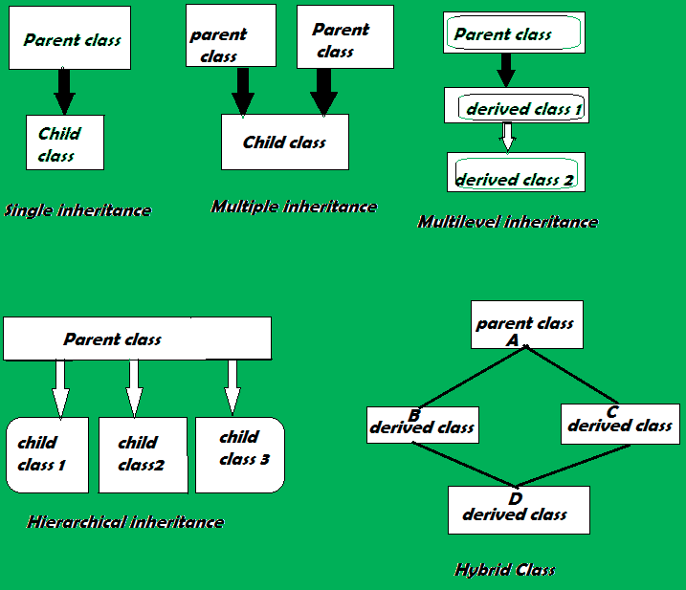
Inheritance
Inheritance is the ability of one class to inherit capabilities or properties of another class, called the parent class.
When we write a class, we inherit properties from other classes.
So when we create a class, we do not need to write all the properties and functions again and again, as these can be inherited from another class that possesses it.
Inheritance allows the user to reuse the code whenever possible and reduce its redundancy.

Slide 14
Inheritance in Java
Inheritance is an important pillar of OOP(Object-Oriented Programming). It is the mechanism in java by which one class is allowed to inherit the features(fields and methods) of another class.
Important terminology:
Super Class: The class whose features are inherited is known as superclass(or a base class or a parent class).
Sub Class: The class that inherits the other class is known as a subclass(or a derived class, extended class, or child class). The subclass can add its own fields and methods in addition to the superclass fields and methods.
Reusability: Inheritance supports the concept of “reusability”, i.e. when we want to create a new class and there is already a class that includes some of the code that we want, we can derive our new class from the existing class. By doing this, we are reusing the fields and methods of the existing class.
How to use inheritance in Java
The keyword used for inheritance is extends.
class derived-class extends base-class
{
//methods and fields
}

Slide 15
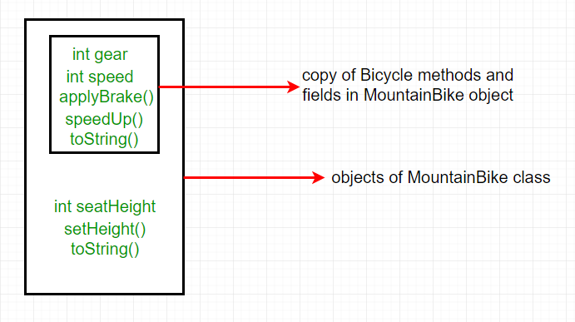
// Java program to illustrate the
// concept of inheritance
// base class
class Bicycle {
// the Bicycle class has two fields
public int gear;
public int speed;
// the Bicycle class has one constructor
public Bicycle(int gear, int speed)
{
this.gear = gear;
this.speed = speed;
}
// the Bicycle class has three methods
public void applyBrake(int decrement)
{
speed -= decrement;
}
public void speedUp(int increment)
{
speed += increment;
}
// toString() method to print info of Bicycle
public String toString()
{
return ("No of gears are " + gear + "\n"
+ "speed of bicycle is " + speed);
}
}
// derived class
class MountainBike extends Bicycle {
// the MountainBike subclass adds one more field
public int seatHeight;
// the MountainBike subclass has one constructor
public MountainBike(int gear, int speed,
int startHeight)
{
// invoking base-class(Bicycle) constructor
super(gear, speed);
seatHeight = startHeight;
}
// the MountainBike subclass adds one more method
public void setHeight(int newValue)
{
seatHeight = newValue;
}
// overriding toString() method
// of Bicycle to print more info
@Override public String toString()
{
return (super.toString() + "\nseat height is "
+ seatHeight);
}
}
// driver class
public class Test {
public static void main(String args[])
{
MountainBike mb = new MountainBike(3, 100, 25);
System.out.println(mb.toString());
}
}
In the above program, when an object of MountainBike class is created, a copy of all methods and fields of the superclass acquire memory in this object. That is why by using the object of the subclass we can also access the members of a superclass.
Please note that during inheritance only the object of the subclass is created, not the superclass.

Slide 16
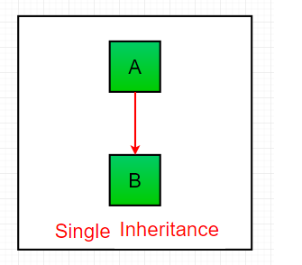
Types of Inheritance in Java
// Java program to illustrate the
// concept of single inheritance
import java.io.*;
import java.lang.*;
import java.util.*;
class one {
public void print_geek()
{
System.out.println("Geeks");
}
}
class two extends one {
public void print_for() { System.out.println("for"); }
}
// Driver class
public class Main {
public static void main(String[] args)
{
two g = new two();
g.print_geek();
g.print_for();
g.print_geek();
}
}
1. Single Inheritance: In single inheritance, subclasses inherit the features of one superclass. In the image below, class A serves as a base class for the derived class B.
Output
Geeks
for
Geeks

Slide 17
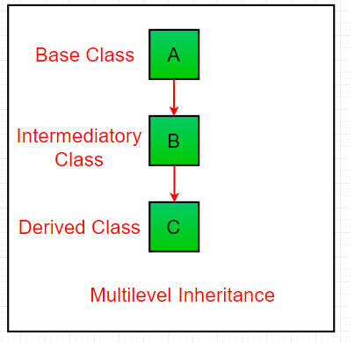
Types of Inheritance in Java
// Java program to illustrate the
// concept of Multilevel inheritance
import java.io.*;
import java.lang.*;
import java.util.*;
class one {
public void print_geek()
{
System.out.println("Geeks");
}
}
class two extends one {
public void print_for() { System.out.println("for"); }
}
class three extends two {
public void print_geek()
{
System.out.println("Geeks");
}
}
// Drived class
public class Main {
public static void main(String[] args)
{
three g = new three();
g.print_geek();
g.print_for();
g.print_geek();
}
}
2. Multilevel Inheritance: In Multilevel Inheritance, a derived class will be inheriting a base class and as well as the derived class also act as the base class to other class. In the below image, class A serves as a base class for the derived class B, which in turn serves as a base class for the derived class C.
Output
Geeks
for
Geeks

Slide 18
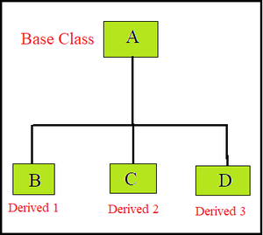
Types of Inheritance in Java
// Java program to illustrate the
// concept of Hierarchical inheritance
class A {
public void print_A() { System.out.println("Class A"); }
}
class B extends A {
public void print_B() { System.out.println("Class B"); }
}
class C extends A {
public void print_C() { System.out.println("Class C"); }
}
class D extends A {
public void print_D() { System.out.println("Class D"); }
}
// Driver Class
public class Test {
public static void main(String[] args)
{
B obj_B = new B();
obj_B.print_A();
obj_B.print_B();
C obj_C = new C();
obj_C.print_A();
obj_C.print_C();
D obj_D = new D();
obj_D.print_A();
obj_D.print_D();
}
}
3. Hierarchical Inheritance: In Hierarchical Inheritance, one class serves as a superclass (base class) for more than one subclass. In the below image, class A serves as a base class for the derived class B, C and D.
Output
Class A
Class B
Class A
Class C
Class A
Class D

Slide 19
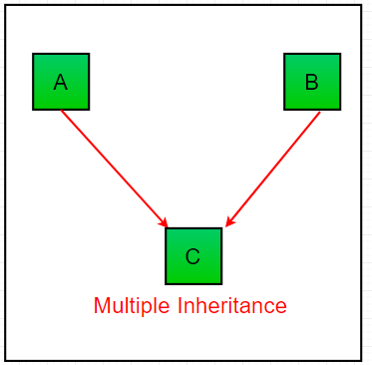
Types of Inheritance in Java
// Java program to illustrate the
// concept of Multiple inheritance
import java.io.*;
import java.lang.*;
import java.util.*;
interface one {
public void print_geek();
}
interface two {
public void print_for();
}
interface three extends one, two {
public void print_geek();
}
class child implements three {
@Override public void print_geek()
{
System.out.println("Geeks");
}
public void print_for() { System.out.println("for"); }
}
// Drived class
public class Main {
public static void main(String[] args)
{
child c = new child();
c.print_geek();
c.print_for();
c.print_geek();
}
}
4. Multiple Inheritance (Through Interfaces): In Multiple inheritances, one class can have more than one superclass and inherit features from all parent classes. Please note that Java does not support multiple inheritances with classes. In java, we can achieve multiple inheritances only through Interfaces. In the image below, Class C is derived from interface A and B.
Output
Geeks
for
Geeks

Slide 20
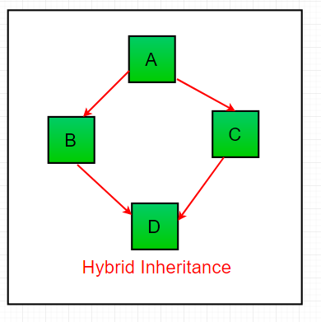
Types of Inheritance in Java
5. Hybrid Inheritance(Through Interfaces): It is a mix of two or more of the above types of inheritance. Since java doesn’t support multiple inheritances with classes, hybrid inheritance is also not possible with classes. In java, we can achieve hybrid inheritance only through Interfaces.

Slide 21
Important facts about inheritance in Java
Default superclass: Except Object class, which has no superclass, every class has one and only one direct superclass (single inheritance). In the absence of any other explicit superclass, every class is implicitly a subclass of the Object class.
Superclass can only be one: A superclass can have any number of subclasses. But a subclass can have only one superclass. This is because Java does not support multiple inheritances with classes. Although with interfaces, multiple inheritances are supported by java.
Inheriting Constructors: A subclass inherits all the members (fields, methods, and nested classes) from its superclass. Constructors are not members, so they are not inherited by subclasses, but the constructor of the superclass can be invoked from the subclass.
Private member inheritance: A subclass does not inherit the private members of its parent class. However, if the superclass has public or protected methods(like getters and setters) for accessing its private fields, these can also be used by the subclass.

Slide 22
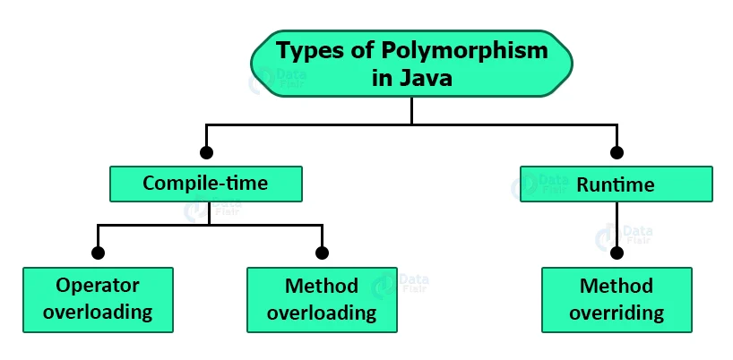
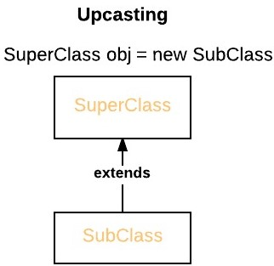
Polymorphism
Polymorphism means many forms. It is the ability to take more than one form. It is a feature that provides a function or an operator with more than one definition. It can be implemented using function overloading, function overriding, operator overloading.
Method overriding is one of the ways in which Java supports Runtime Polymorphism. Dynamic method dispatch is the mechanism by which a call to an overridden method is resolved at run time, rather than compile time.
When an overridden method is called through a superclass reference, Java determines which version(superclass/subclasses) of that method is to be executed based upon the type of the object being referred to at the time the call occurs. Thus, this determination is made at run time.
At run-time, it depends on the type of the object being referred to (not the type of the reference variable) that determines which version of an overridden method will be executed
A superclass reference variable can refer to a subclass object. This is also known as upcasting. Java uses this fact to resolve calls to overridden methods at run time.
Java doesn't supports operator overloading because it's just a choice made by its creators who wanted to keep the language more simple. Every operator has a good meaning with its arithmetic operation it performs. Operator overloading allows you to do something extra than what for it is expected for.

Slide 23
Overloading in Java
// Java program to demonstrate working of method
// overloading in Java.
public class Sum {
// Overloaded sum(). This sum takes two int parameters
public int sum(int x, int y)
{
return (x + y);
}
// Overloaded sum(). This sum takes three int parameters
public int sum(int x, int y, int z)
{
return (x + y + z);
}
// Overloaded sum(). This sum takes two double parameters
public double sum(double x, double y)
{
return (x + y);
}
// Driver code
public static void main(String args[])
{
Sum s = new Sum();
System.out.println(s.sum(10, 20));
System.out.println(s.sum(10, 20, 30));
System.out.println(s.sum(10.5, 20.5));
}
}
Overloading allows different methods to have the same name, but different signatures where the signature can differ by the number of input parameters or type of input parameters or both. Overloading is related to compile-time (or static) polymorphism.
Ways of Overloading Methods
Method overloading can be done by changing:
The number of parameters in two methods.
The data types of the parameters of methods.
The Order of the parameters of methods.

Slide 24
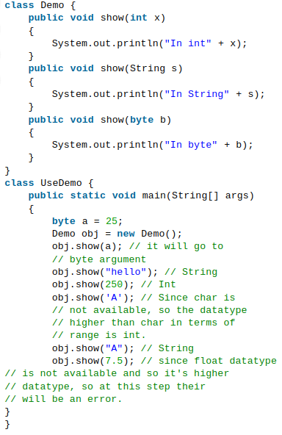
Q. What if the exact prototype does not match with arguments.
Priority wise, compiler take these steps:
Type Conversion but to higher type(in terms of range) in same family.
Type conversion to next higher family(suppose if there is no long data type available for an int data type, then it will search for the float data type).
What is the advantage?
We don’t have to create and remember different names for functions doing the same thing. For example, in our code, if overloading was not supported by Java, we would have to create method names like sum1, sum2, … or sum2Int, sum3Int, … etc.
Can we overload methods on return type?
We cannot overload by return type.
Can we overload static methods?
The answer is ‘Yes’. We can have two ore more static methods with same name, but differences in input parameters.
Can we overload methods that differ only by static keyword?
We cannot overload two methods in Java if they differ only by static keyword (number of parameters and types of parameters is same).

Slide 25
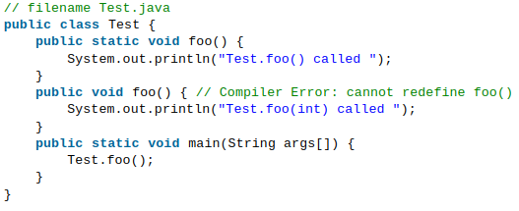
Can we overload methods that differ only by static keyword?
We cannot overload two methods in Java if they differ only by static keyword (number of parameters and types of parameters is the same).
Output:
Compiler Error, cannot redefine foo()

Slide 26
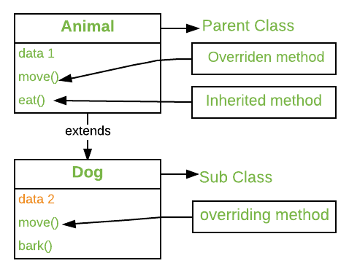
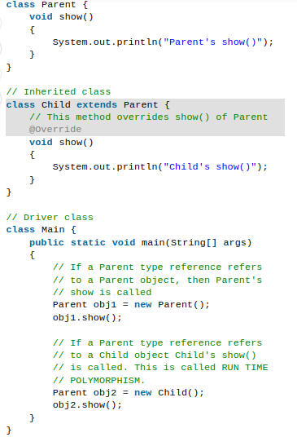
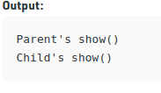
Overriding in Java
In any object-oriented programming language, Overriding is a feature that allows a subclass or child class to provide a specific implementation of a method that is already provided by one of its super-classes or parent classes. When a method in a subclass has the same name, same parameters or signature, and same return type(or sub-type) as a method in its super-class, then the method in the subclass is said to override the method in the super-class.
Method overriding is one of the way by which java achieve Run Time Polymorphism.
The version of a method that is executed will be determined by the object that is used to invoke it. If an object of a parent class is used to invoke the method, then the version in the parent class will be executed, but if an object of the subclass is used to invoke the method, then the version in the child class will be executed. In other words, it is the type of the object being referred to (not the type of the reference variable) that determines which version of an overridden method will be executed.

Slide 27
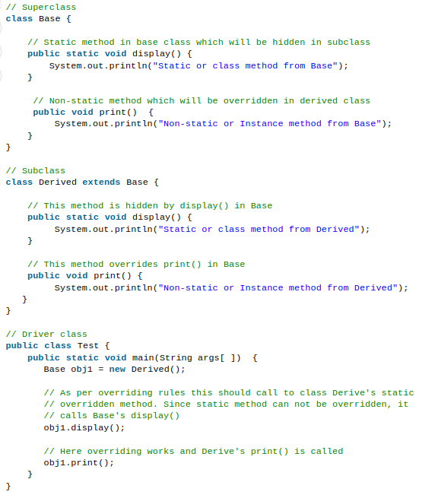
Can we Override static methods in java?
We can declare static methods with the same signature in the subclass, but it is not considered overriding as there won’t be any run-time polymorphism. Hence the answer is ‘No’.
If a derived class defines a static method with the same signature as a static method in the base class, the method in the derived class is hidden by the method in the base class.
Output
Static or class method from Base
Non-static or Instance method from Derived

Slide 28
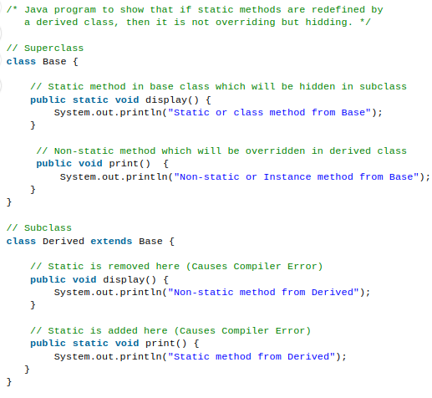
The following are some important points for method overriding and static methods in Java.
1) For static methods, the method according to the type of reference is called, not according to the object being referred, which means method call is decided at compile time.
2) For instance (or non-static) methods, the method is called according to the type of object being referred, not according to the type of reference, which means method calls is decided at run time.
3) An instance method cannot override a static method, and a static method cannot hide an instance method. For example, this program has two compiler errors.
4) In a subclass (or Derived Class), we can overload the methods inherited from the superclass. Such overloaded methods neither hide nor override the superclass methods — they are new methods, unique to the subclass.

Slide 29
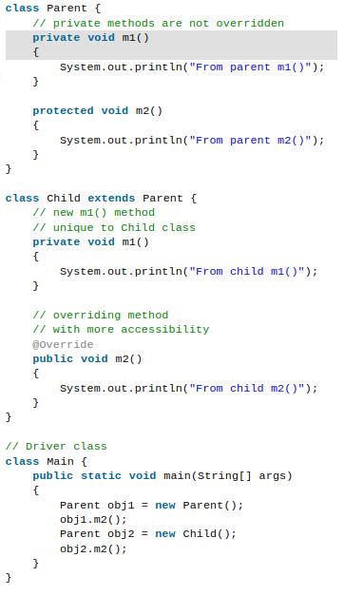
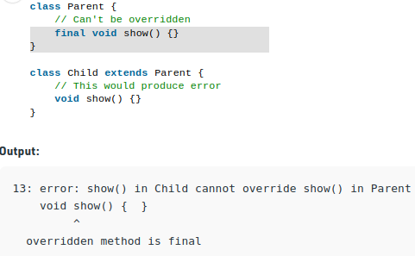
Rules for method overriding
Overriding and Access-Modifiers : The access modifier for an overriding method can allow more, but not less, access than the overridden method. For example, a protected instance method in the super-class can be made public, but not private, in the subclass. Doing so, will generate compile-time error.
Final methods can not be overridden : If we don’t want a method to be overridden, we declare it as final. Please see Using final with Inheritance .

Slide 30
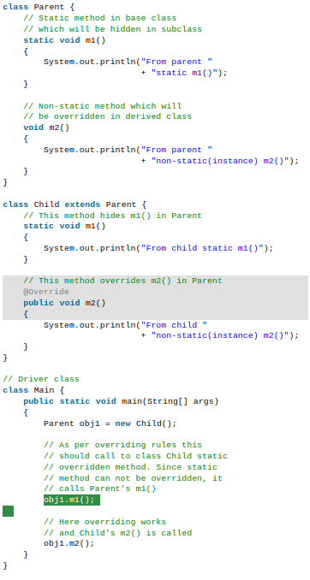
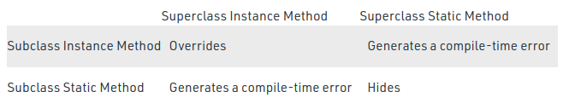

Rules for method overriding
Static methods can not be overridden(Method Overriding vs Method Hiding) : When you define a static method with same signature as a static method in base class, it is known as method hiding.
The following table summarizes what happens when you define a method with the same signature as a method in a super-class.

Slide 31
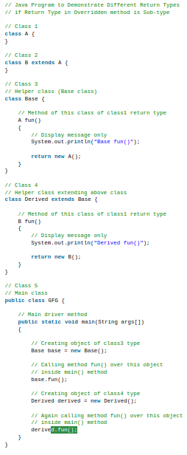
Rules for method overriding
Private methods can not be overridden : Private methods cannot be overridden as they are bonded during compile time. Therefore we can’t even override private methods in a subclass.
The overriding method must have same return type (or subtype) : From Java 5.0 onwards it is possible to have different return type for a overriding method in child class, but child’s return type should be sub-type of parent’s return type. This phenomena is known as covariant return type.
Output:
Base fun()
Derived fun()

Slide 32
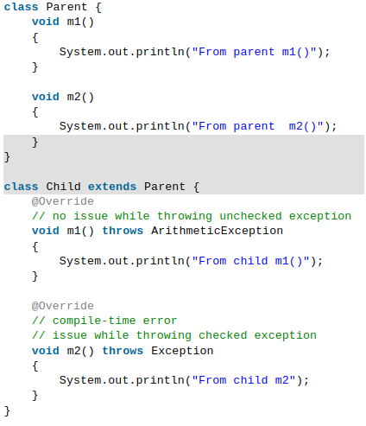
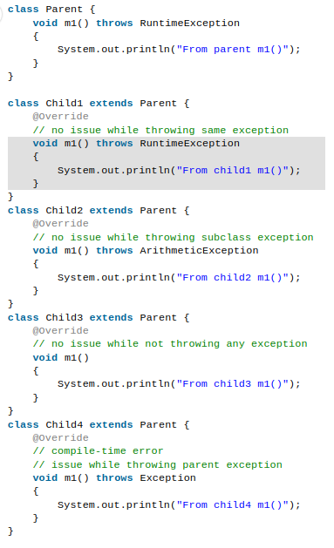
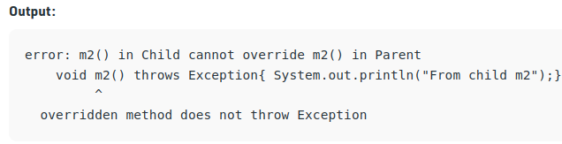
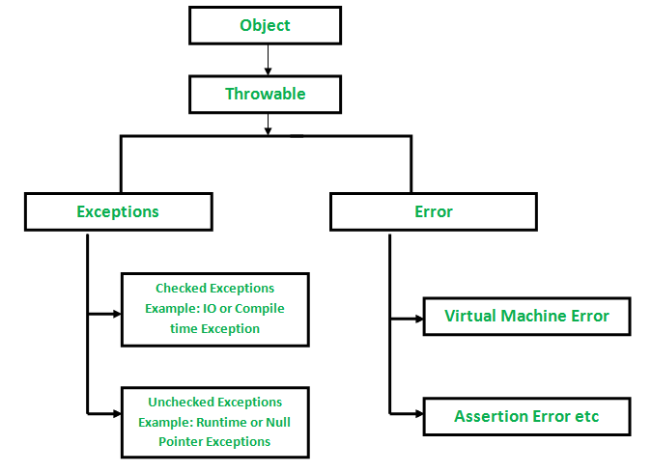
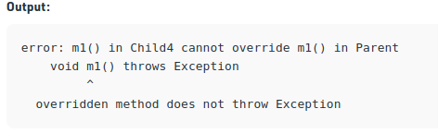
Rules for method overriding
Rule#1
Overriding and constructor : We can not override constructor as parent and child class can never have constructor with same name(Constructor name must always be same as Class name).
Overriding and Exception-Handling : two rules to note when overriding methods related to exception-handling.
Rule#1 : If the super-class overridden method does not throw an exception, subclass overriding method can only throws the unchecked exception, throwing checked exception will lead to compile-time error.
Rule#2 : If the super-class overridden method does throws an exception, subclass overriding method can only throw same, subclass exception Throwing parent exception in Exception hierarchy will lead to compile time error.Also there is no issue if subclass overridden method is not throwing any exception.
Rule#2

Slide 33
Rules for method overriding
Overriding and abstract method: Abstract methods in an interface or abstract class are meant to be overridden in derived concrete classes otherwise a compile-time error will be thrown.

Slide 34
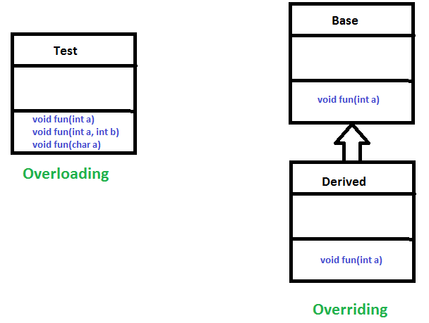
What is the difference between Overloading and Overriding?
Overloading is about same function have different signatures.
Overriding is about same function, same signature but different classes connected through inheritance.
Overloading is an example of compile time polymorphism and
overriding is an example of run time polymorphism

Slide 35
Why Method Overriding ?
Overridden methods allow Java to support run-time polymorphism. Polymorphism is essential to object-oriented programming for one reason: it allows a general class to specify methods that will be common to all of its derivatives while allowing subclasses to define the specific implementation of some or all of those methods. Overridden methods are another way that Java implements the “one interface, multiple methods” aspect of polymorphism.
Overridden methods allow us to call methods of any of the derived classes without even knowing the type of derived class object.

Slide 36
Advantages of Polymorphism in Java
A single function can behave differently in different classes.
Eliminates the need for declaring different function names for the same implementation
Implementing inheritance is easier with polymorphism.
Disadvantages of Polymorphism in Java
Runtime polymorphism degrades machine performance as the compiler decides the return type of the method during execution.
The readability of the program decreases because the runtime implementation points to how much time the program is going to take to execute.

Slide 37
OOPs, SOLID Design Principles:
Design principles are generalized pieces of advice or proven good coding practices that are used as rules of thumb when making design choices. Some of the most important design principles in the object-oriented paradigm are :
Single Responsibility Principle (SRP):
It states that a class should have one and only one reason to be changed. If you put more than one functionality in one class in Java, it introduces coupling between two functionality, and even if you change one feature, there is a chance you broke coupled functionality, which requires another round of testing to avoid any surprise on the production environment.
Open Closed Design Principle:
It states that Software components should be open for extension, but closed for modification. It prevents someone from changing already tried and tested code. Ideally, if you are adding new functionality only then your code should be tested and that’s the goal of the Open Closed Design principle.
Liskov Substitution Principle (LSP):
According to the Liskov Substitution Principle(LSP), derived classes should be able to substitute their base classes without the behavior of your code changes. It means the methods or functions which use the superclass type must be able to work with the object of the subclass without any issue.
Interface Segregation Principle (ISP):
It states that the client should never be forced to depend on an interface they aren’t using in its entirety. This means that an interface should have a minimum set of methods necessary for the functionality it ensures and should be limited to only one functionality.
Don’t Repeat Yourself (DRY):
It means don’t write duplicate code, instead use Abstraction to abstract common things in one place. if you use a hardcoded value more than one time consider making it public final constant, if you have a block of code in more than two places consider making it a separate method.

Slide 38
Advantages of OOPs in Java
OOP provides a clear modular structure for programs which makes it good for defining abstract data types where implementation details are hidden and the unit has a clearly defined interface.
OOP makes it easy to maintain and modify existing code as new objects can be created with small differences to existing ones.
OOP provides a good framework for code libraries where supplied software components can be easily adapted and modified by the programmer. This is particularly useful for developing graphical user interfaces.
It is a secured development technique.
Everything is treated as objects.
It offers the reusability of classes. That is already created without writing them again and again.
The programmers are written in the OOPS method. So easier to test, manage as well as maintain.

Slide 39
Disadvantages of OOPs in Java
Creating a program in the OOPS concept is a little bit difficult.
The size of applications developed with OOPS is larger than the procedural way.
The programmer should have proper planning before creating a program using the OOPS concept.
If a programmer does not have extreme knowledge about programming, then it becomes difficult for them to code and manages.
Due to the large size of the programs its execution speed becomes slow. Even many coding instructions make the execution of the program slower and affect its efficiency.

Slide 40
Thank you…..

